Slide 1
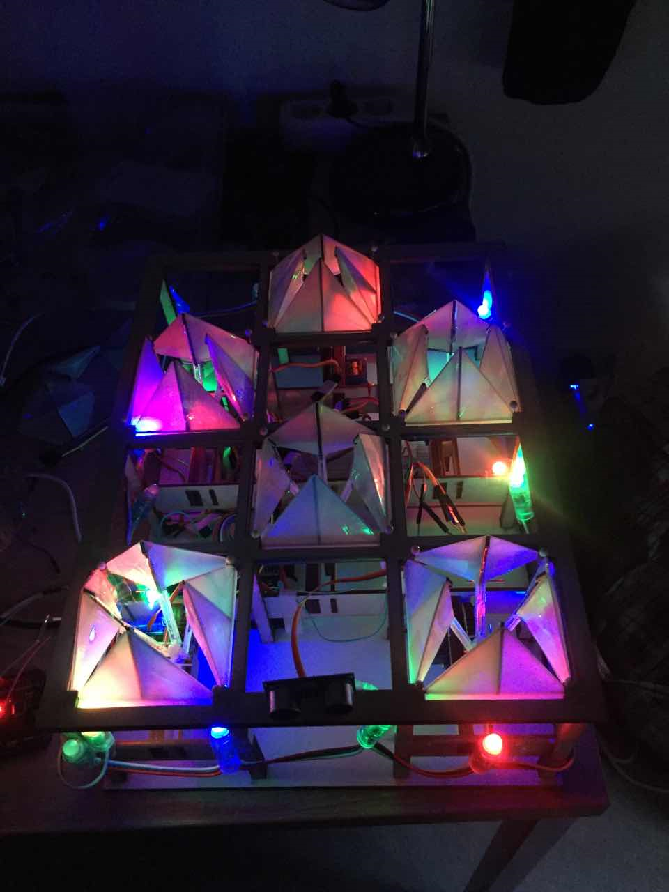
Living organism in reaction to human behaviour
Team members:
Danny
Boyuan

Slide 2
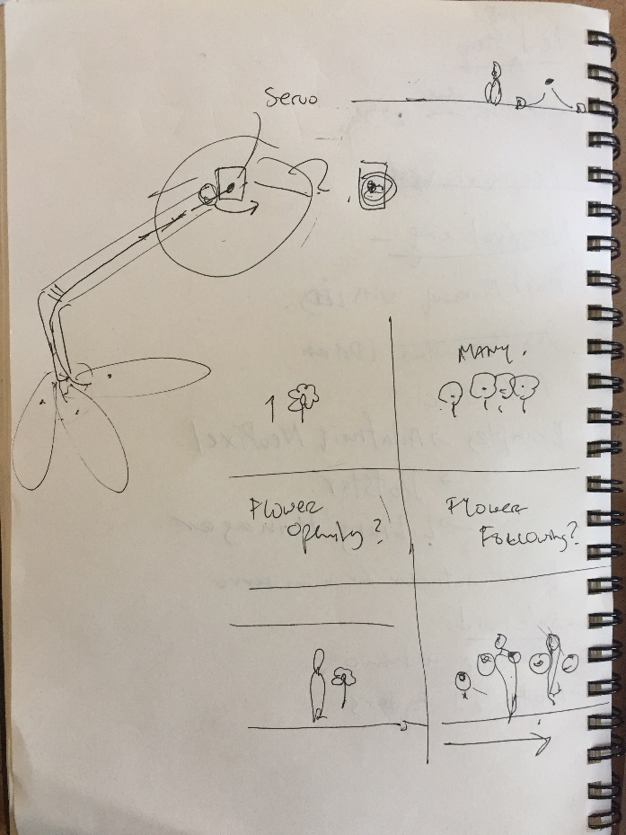
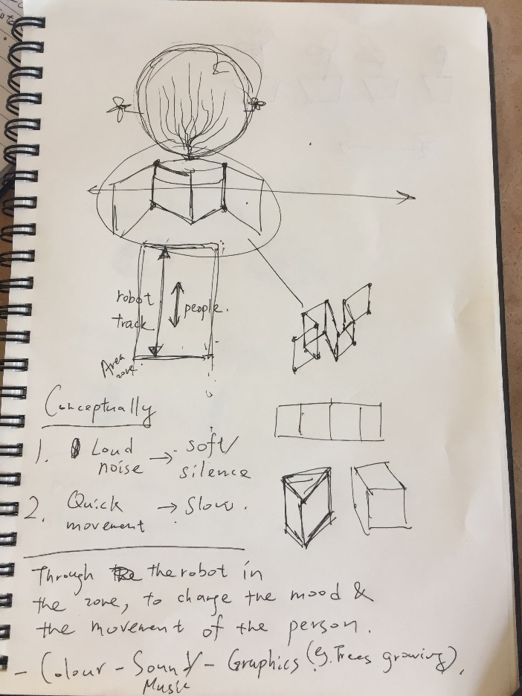

Slide 3
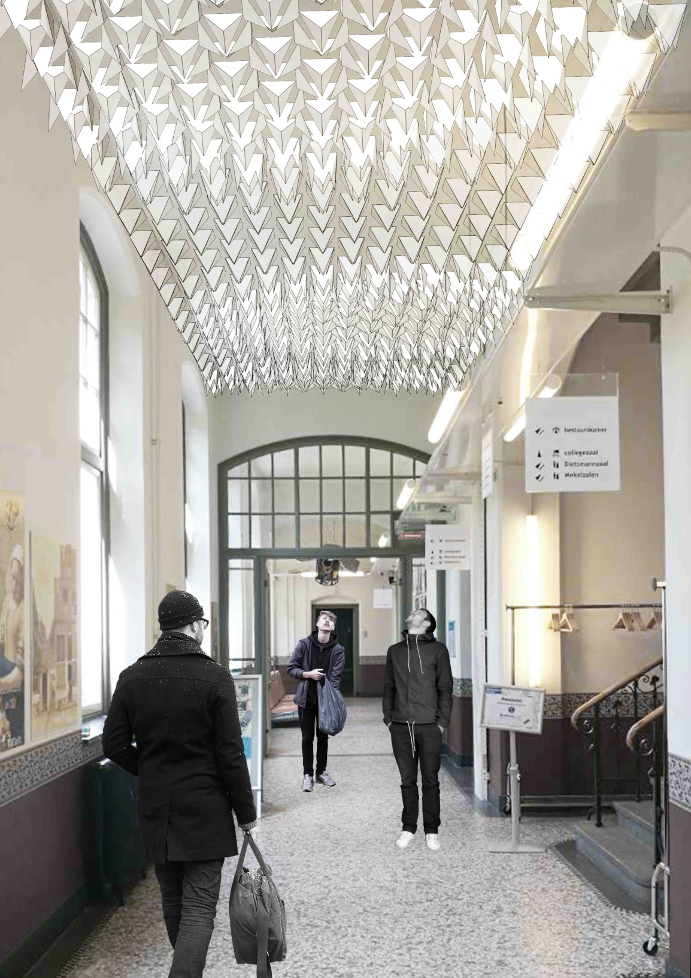
Concepts
Through the flower blooming movement to interact with human behaviour
So that people walking fast in corridor can slow down to appreciate the flower blooming process
The prototype can be installed at the ceiling

Slide 4
Respond to spatial quality of the corridor
When it open , it start to change the volume of the space
When there is no body:
- The ceiling moves as its own living organism
When somebody is there:
- The ceiling movement taken control by human behaviour

Slide 5
Respond to the acoustic quality of the corridor
When it open there is sound absorbing material to absorb noise
When there is too much noise the LED light change colour

Slide 6
Mechanism
Servo motors to drive the movement of the petals of the flower
Ultrasonic sensor to detect the human distance from the flowers
Loudness sensor to detect the noise

